Slide 1
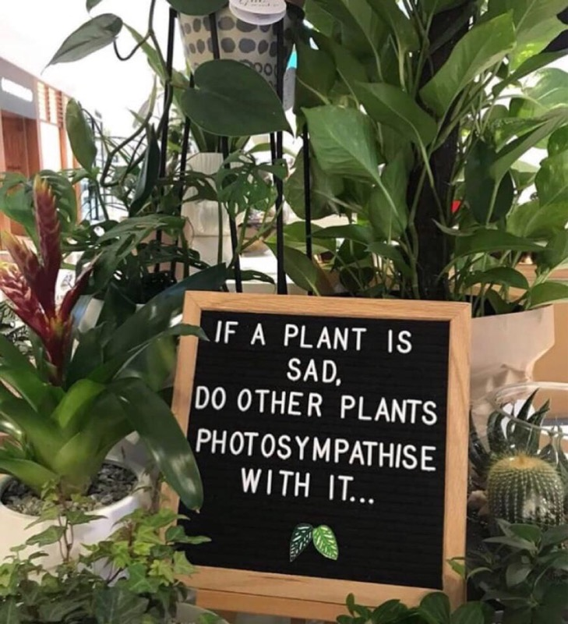

Slide 2
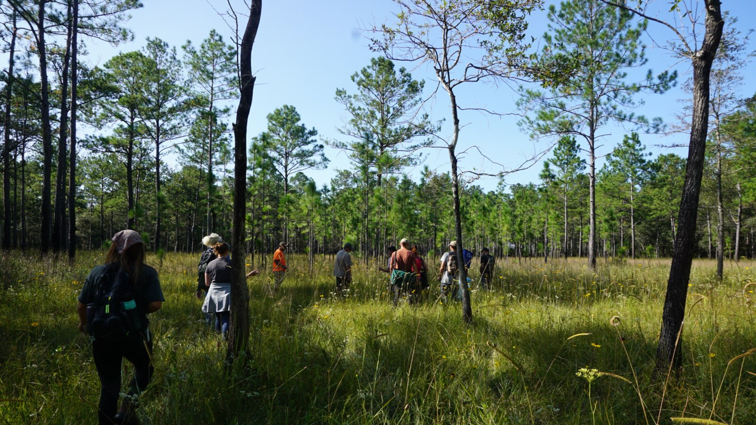
The Botany Club at LSU
Introductory Meeting
Notes:
Welcome! We are so glad that you are interested in the Botany Club at LSU!
We will be discussing what the Botany Club is, why it was founded, membership, and upcoming events.

Slide 3
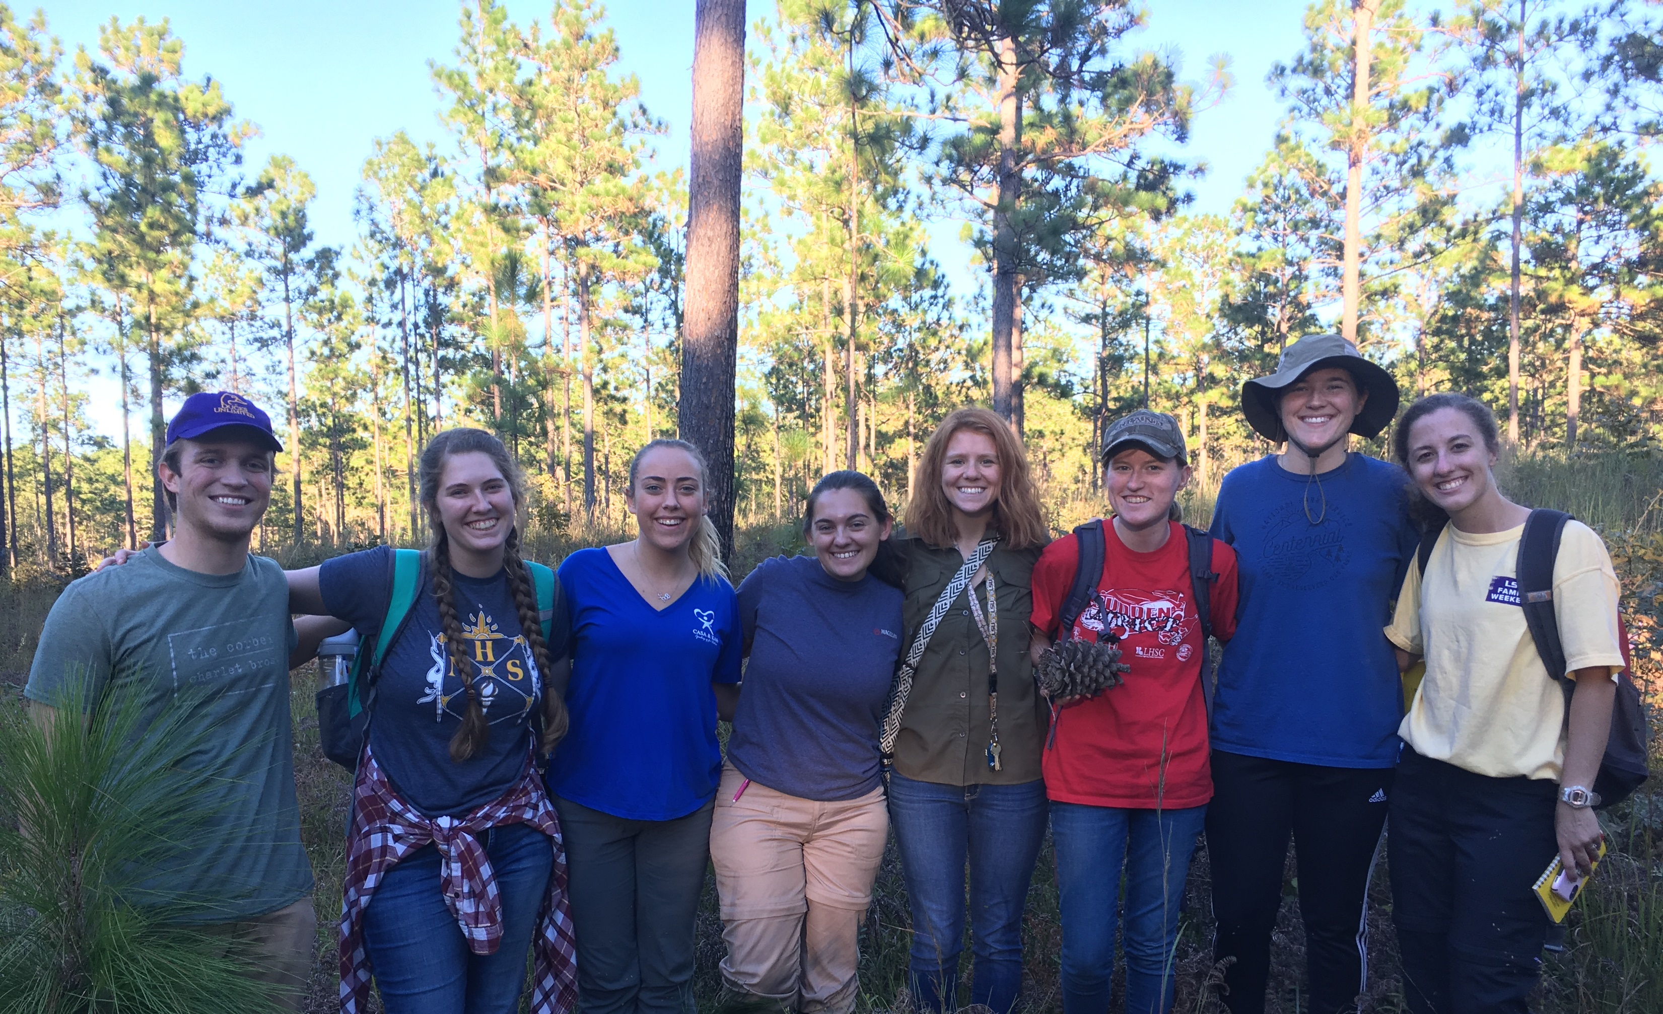
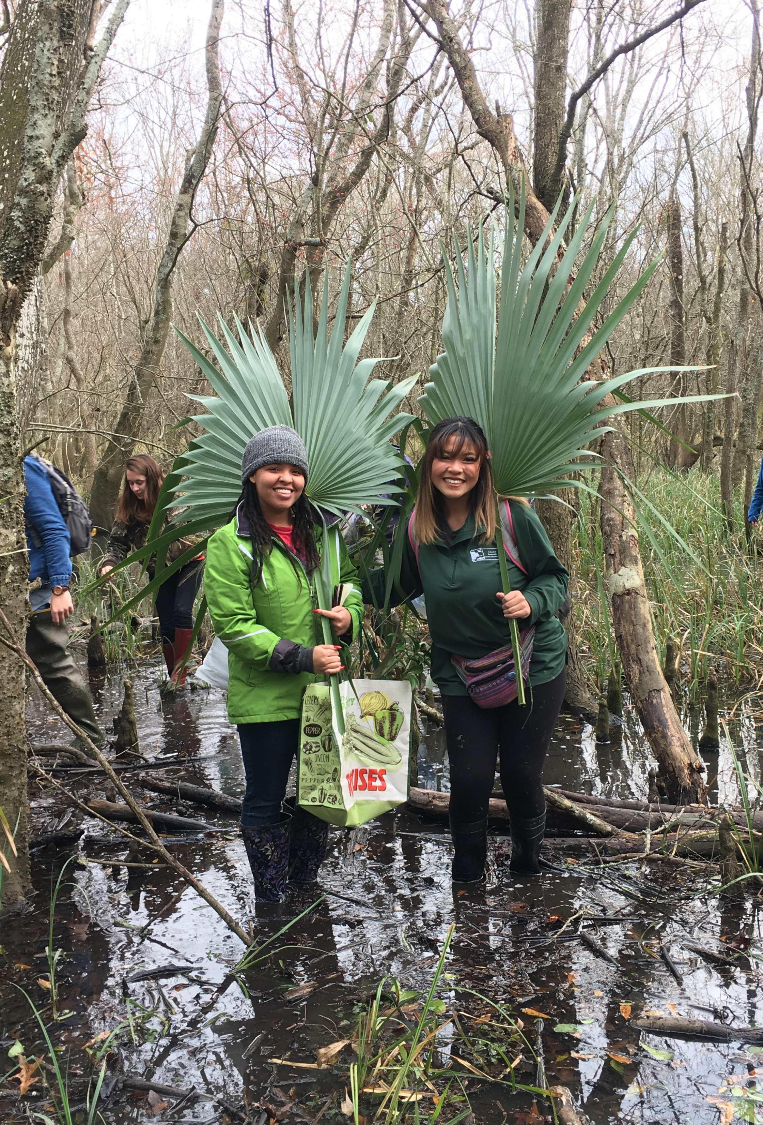
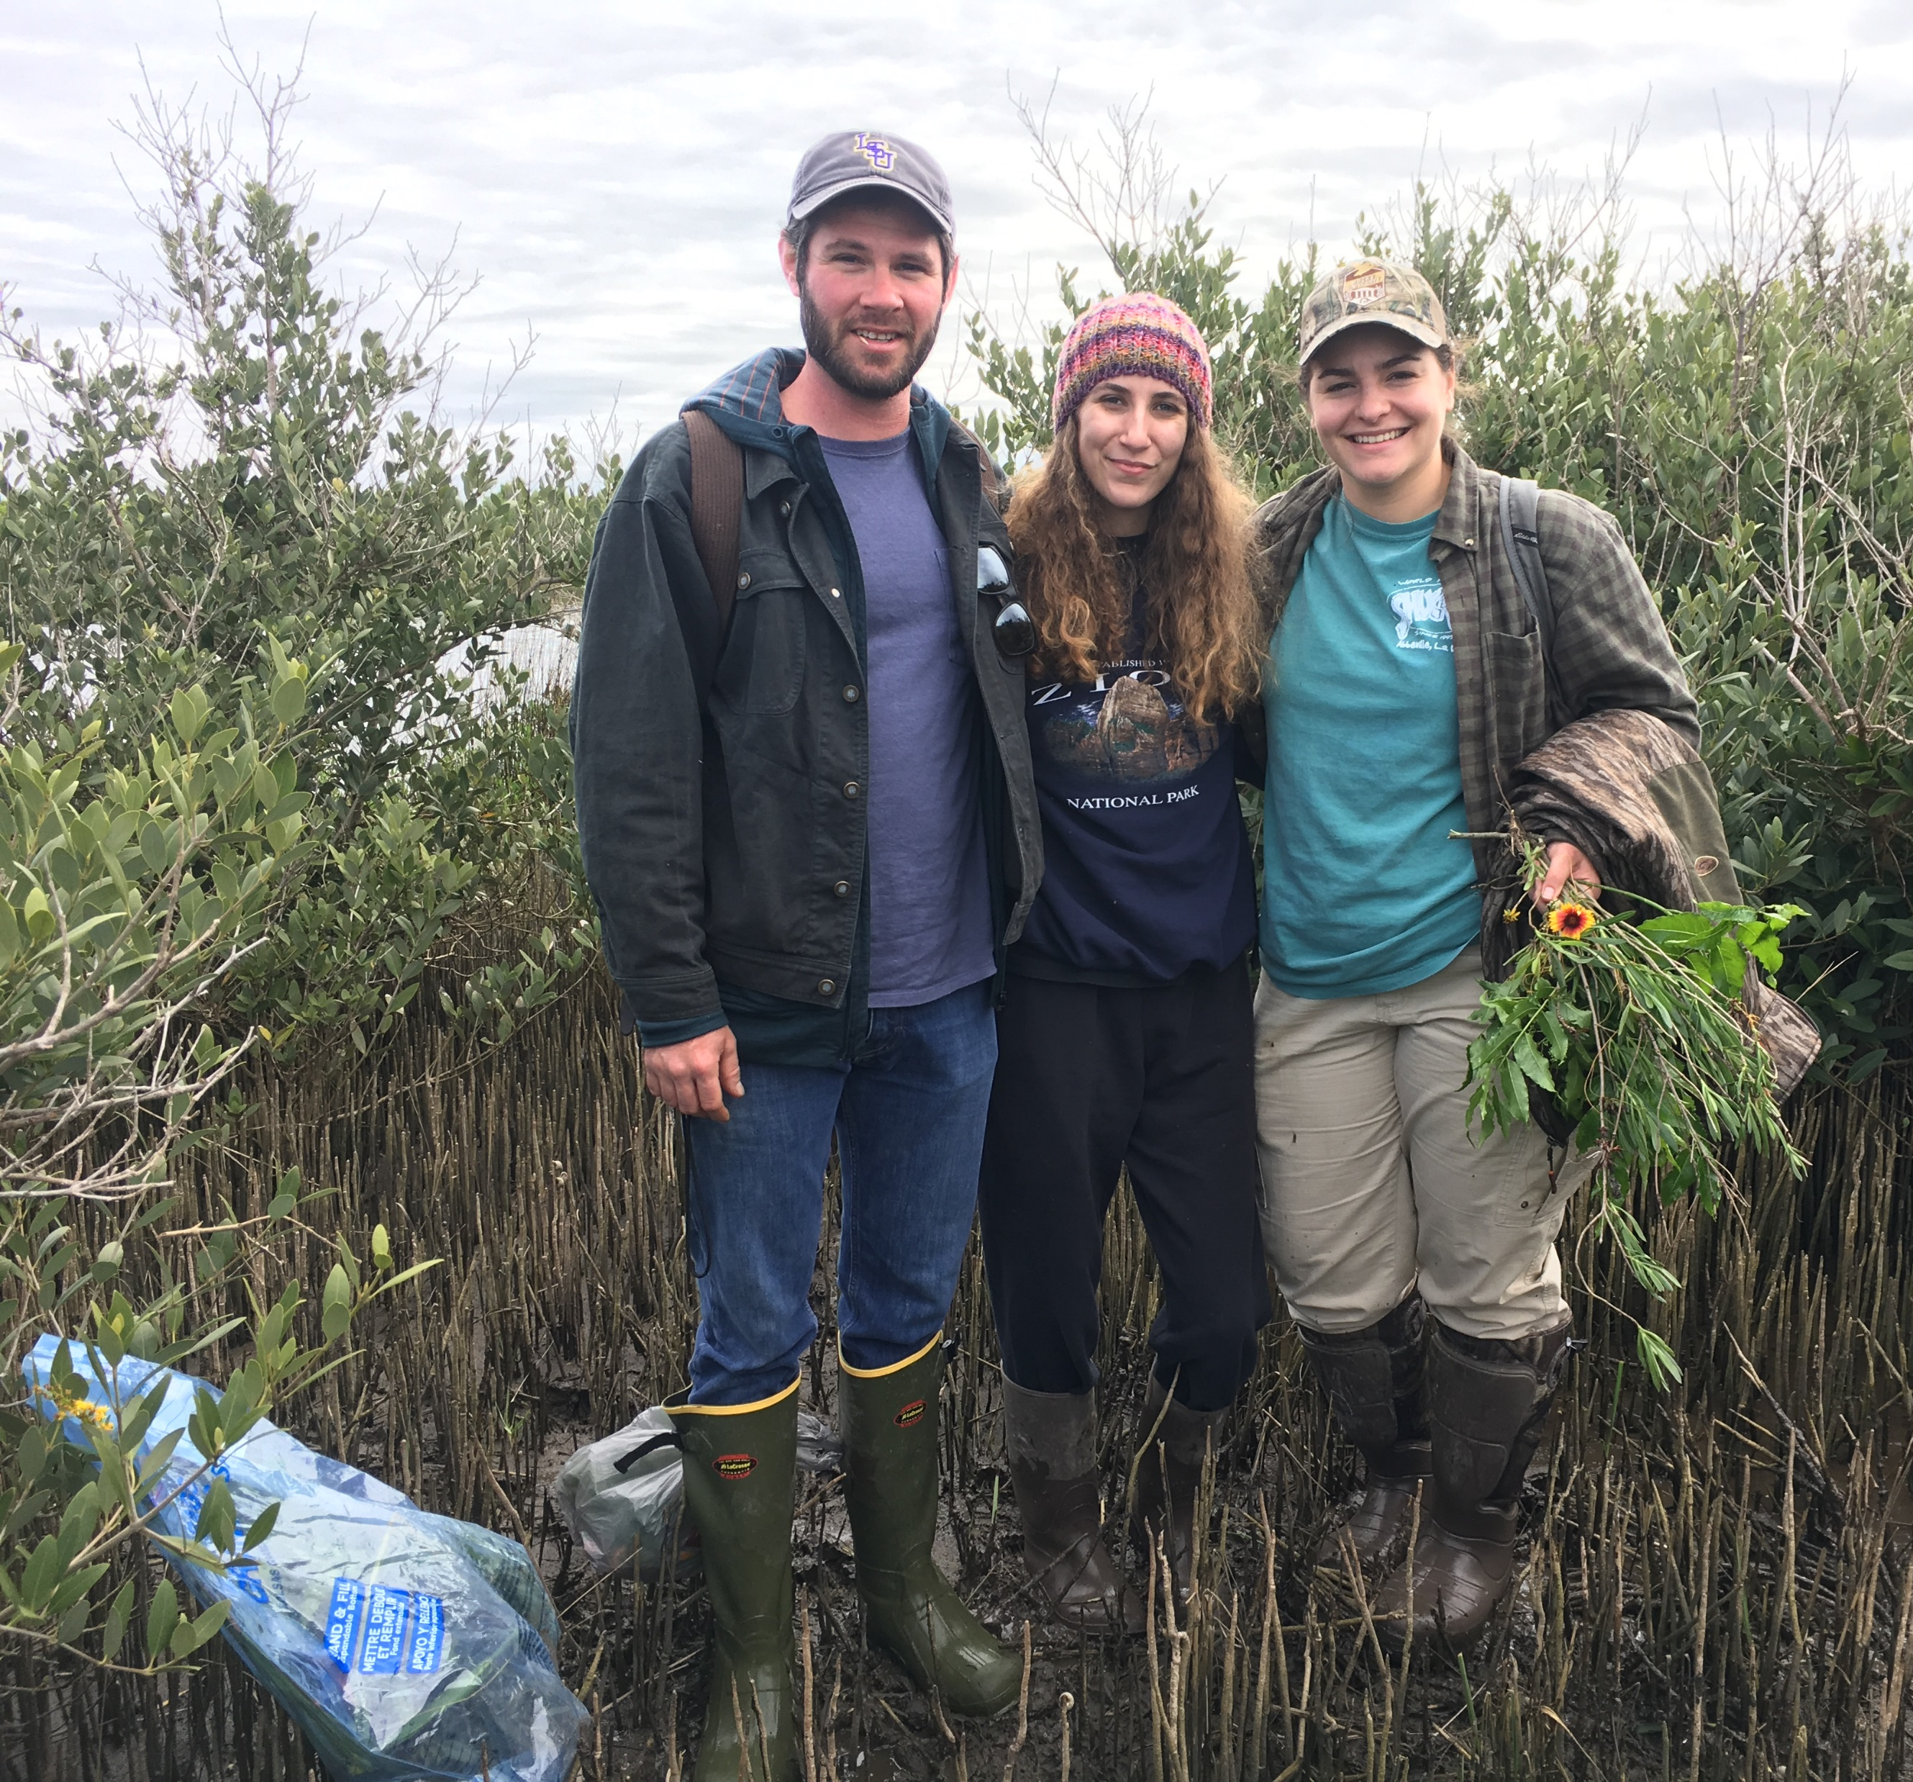
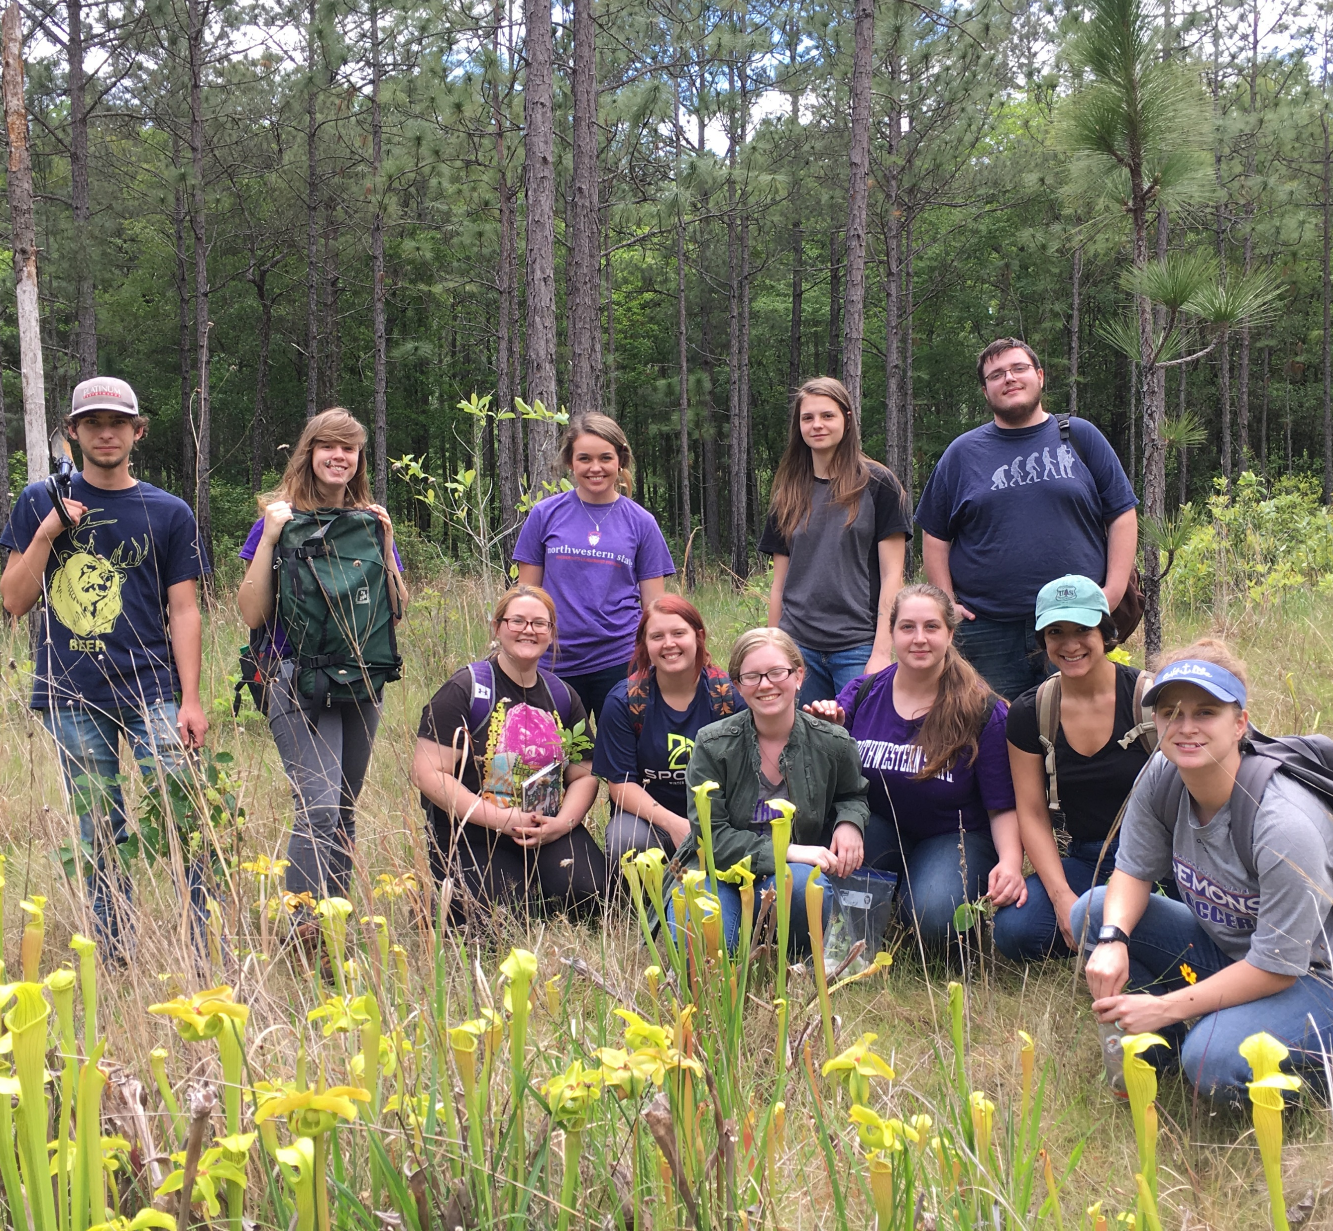
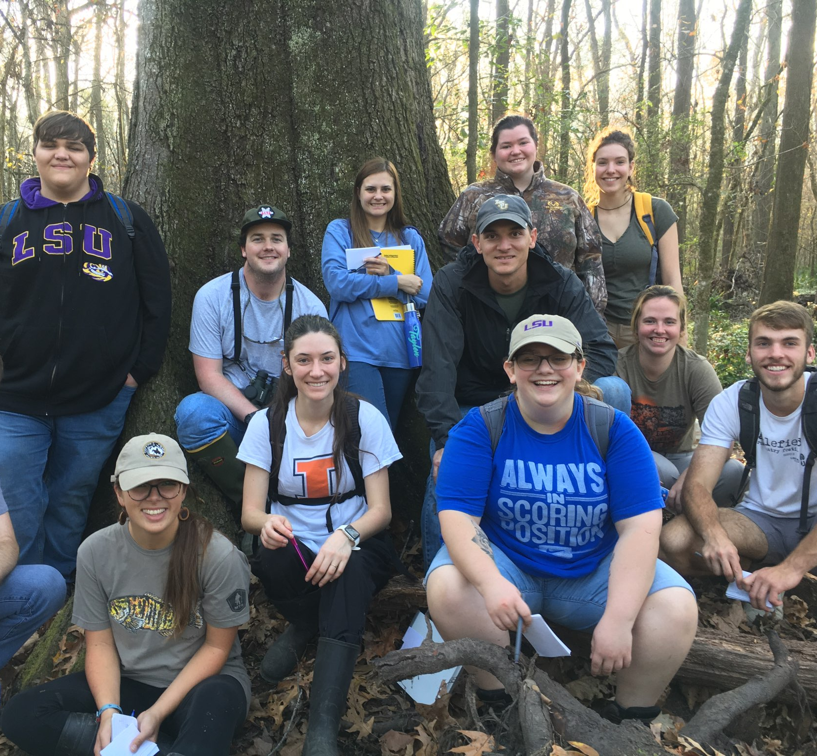
Prairies,
Mangroves,
And Bottomland Hardwood Forests,
Oh My!
Notes:
If you have taken Dendrology ( RNR 2001) with Dr. Reid, you have a pretty good idea of why this club was started. Just a group of people who really enjoy being outside, exploring, and learning about the basis of all life: plants!
We wanted to provide this wonderful experience to as many people as possible, and not limited to just the students of the Renewable Natural Resources Department as it was in the past.

Slide 4

MISSION STATEMENT
The Botany Club was established for continuing education for persons interested in the field of botany through field work and service.
This includes, but is not limited to, the study of plant physiology, genetics, ecology, classification, and identification.
This club will also provide a place for students to network and explore career paths associated with botany.
The 2020 goal for this organization is to provide a safe and beneficial learning environment to supplement the knowledge that students gain in the classroom with hands-on experience.
The club will also contribute to projects of ecological restoration/habitat in natural areas and install additional native plants around the RNR building.

Slide 5

Botanical Society of America
Leading Scientists and Educators since 1893
- Discount on membership!
- Online access to AJB, APS, PSB
- Discounts on publishing in their journal
- Discounts for tickets to the 2021 Botany Conference
- Their virtual plant library
- Online mentoring
- Access to the member directory (HUGE Network)
- Monthly e-newsletter
- Access to over $125,00 in Botanical Society of America scholarships!
- Access to their ever-elusive online video collection
Notes:
80+ Countries of students, teachers, scientist, botanists, professors, and people just plain interested!

Slide 6
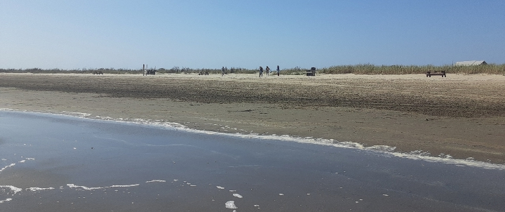
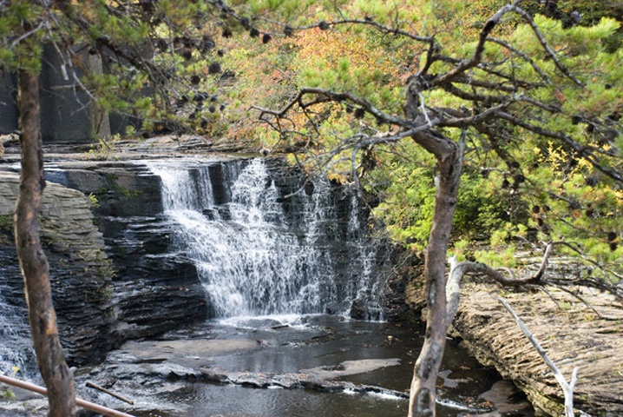
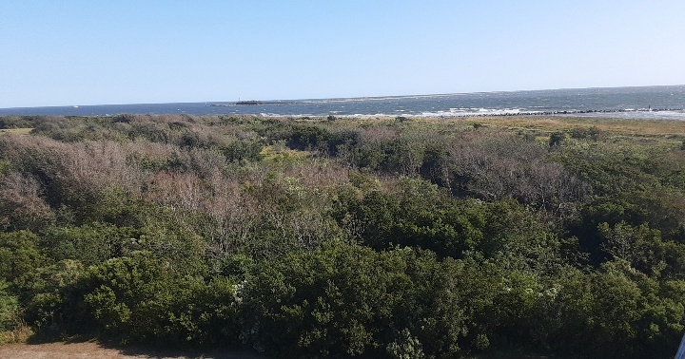
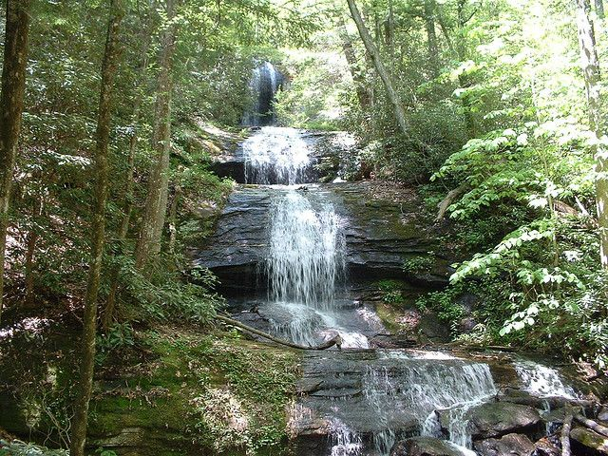
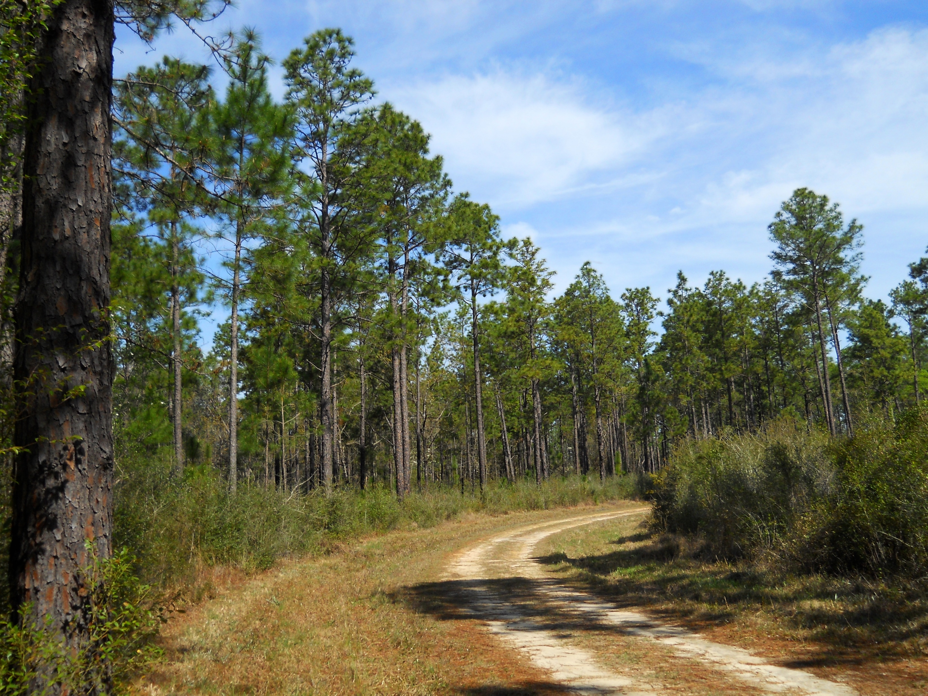
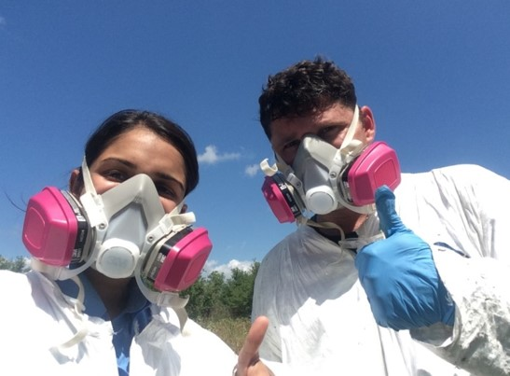

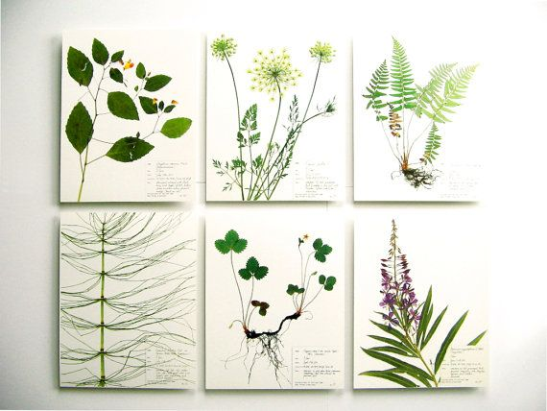
Proposed Projects!
Louisiana coastal prairie clean-up!
Overnight camping trip to De Soto National Forest in Brooklyn, MS
Pressed Plant Specimen Sale!
Notes:
3 hr

Slide 7
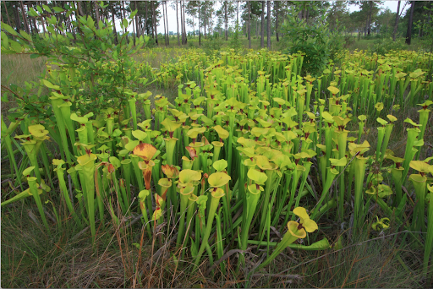
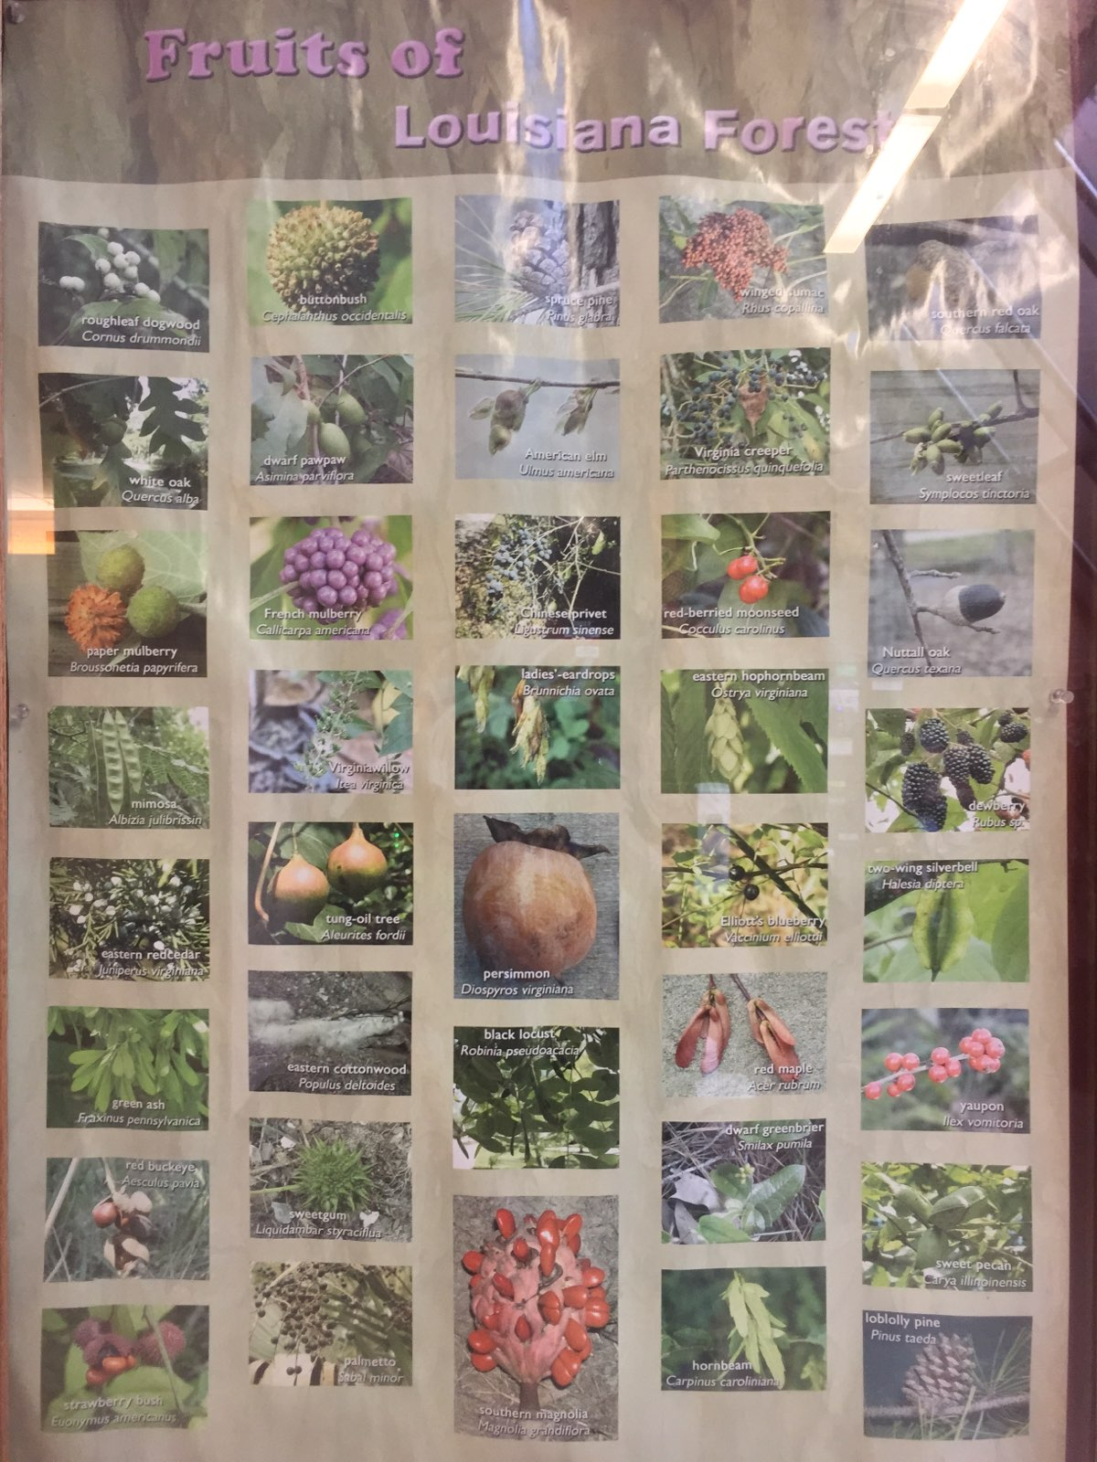
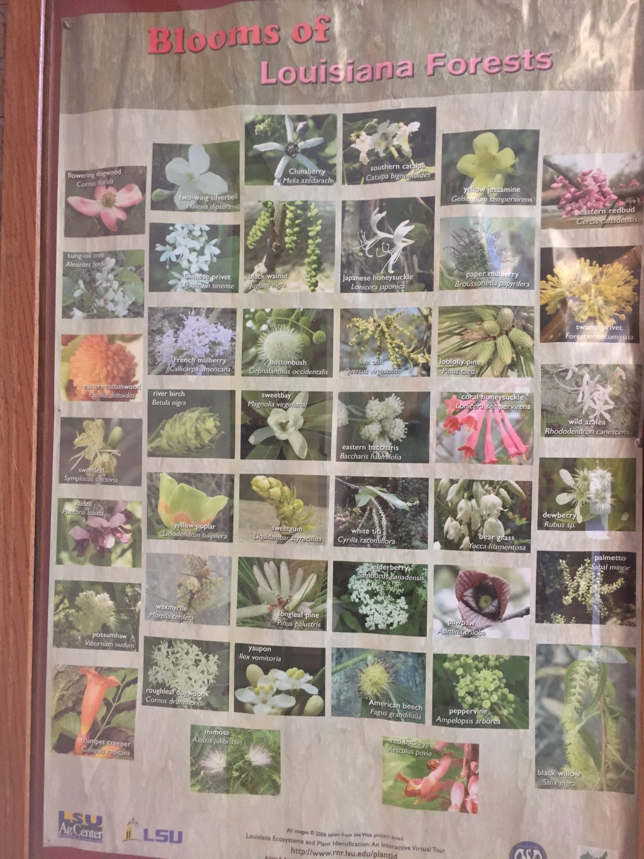
Proposed Projects!
Updating the Botanical Posters of RNR
Cleaning out the front RNR bed and creating a pitcher plant bog in the back!
Notes:
3 hr

Slide 8
How To Become A Member
Contact either Cecilia Berryman at cberr35@lsu.edu or Csanyi Matusicky at cmatus1@lsu.edu
  There are required membership dues of $10 that must be collected by the third meeting that you attend. This will pay for our transportation.
  You must attend 50% of our events
  We will add you to the organization through tigerlink. To view the Botany Club on tigerlink, visit: https://lsu.campuslabs.com/engage/organization/botany

Slide 9
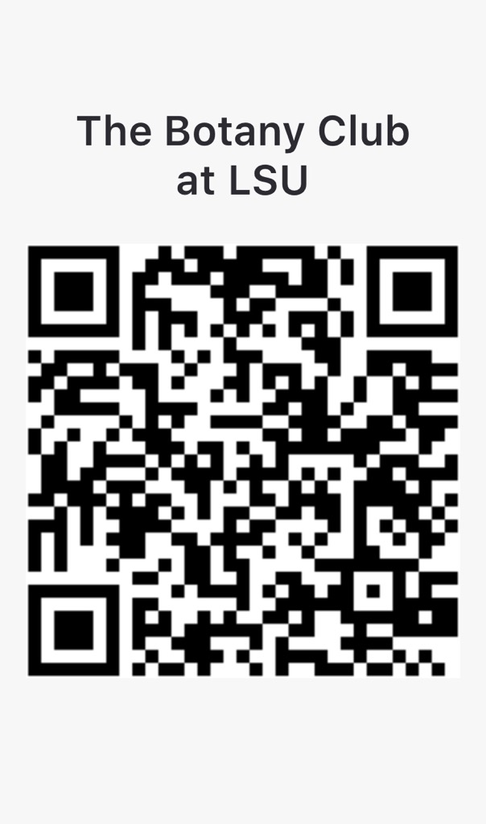
Connect!
Groupme
https://groupme.com/join_group/63446765/VmrnuOWi
Website
https://botanyofrnr.webador.com
Tigerlink
https://lsu.campuslabs.com/engage/organization/botany
Notes:
We will disseminate information through the email list as well as the group me.
The groupme however will be used for polling between club meetings to decide on matters such as when and where to hold activities and meetings.

