Slide 1
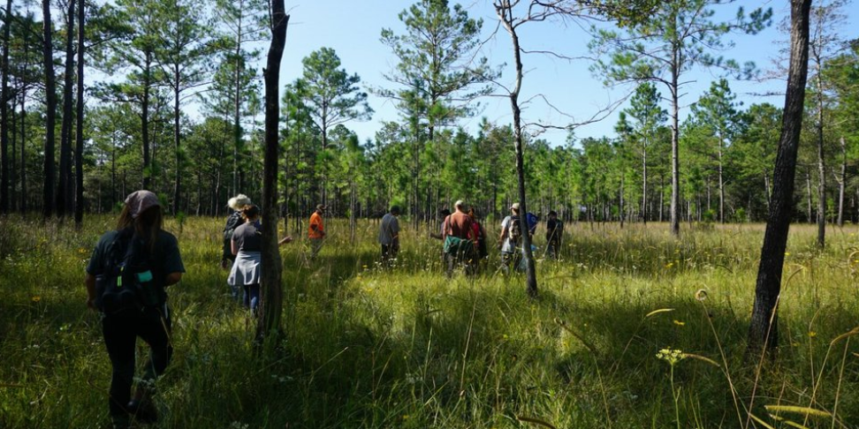
The Botany Club at LSU

Slide 2
The Botany Club was established for continuing education for persons interested in the field of botany through field work and service.
This includes, but is not limited to, the study of plant physiology, genetics, ecology, classification, and identification. This club will also provide a place for students to network and explore career paths associated with botany.
The 2021 goal for this organization is to provide a safe and beneficial learning environment to supplement the knowledge that students gain in the classroom with hands-on experience.
The club will also contribute to projects of ecological restoration/habitat in natural areas and install additional native plants.

Slide 3
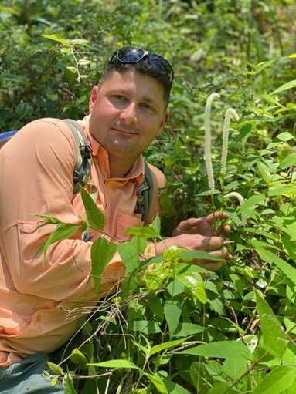
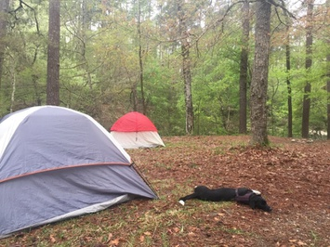
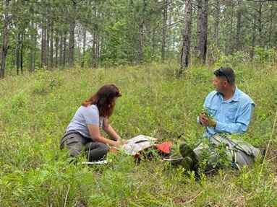
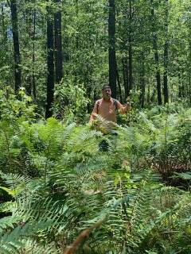
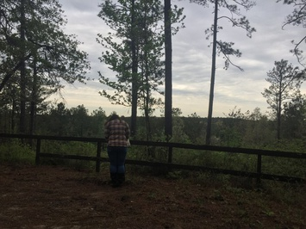

Slide 4
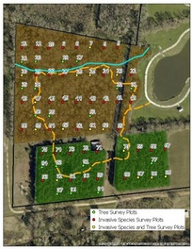
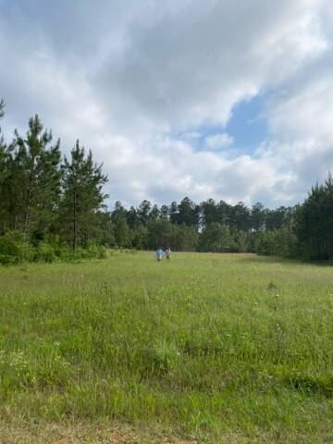
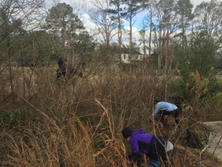
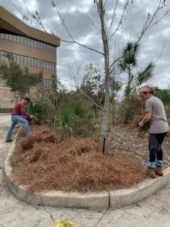
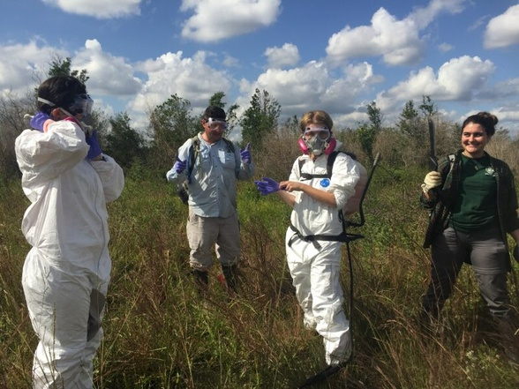

Slide 5
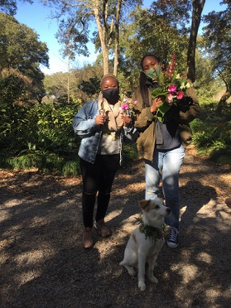
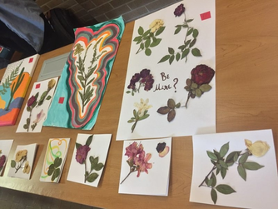
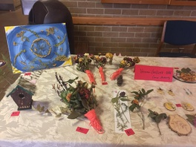
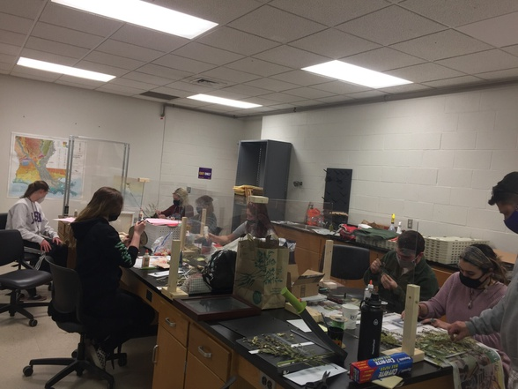

Slide 6
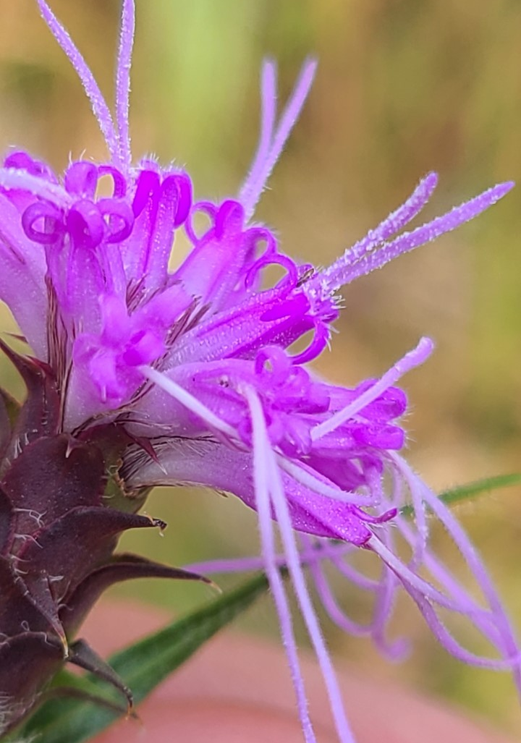
LDWF Garden Day
Day Botanizing trips
- Collect for ID nights
and Art nights
Overnight botanizing trips
Art nights for fundraisers
Prescribed Burns
- BREC, Episcopal,
Cajun Prairie,
Talisheek TNC
Upcoming Events…

Slide 7
Botanical Society of America
Leading Scientists and Educators since 1893
- Discount on membership!
- Online access to AJB, APS, PSB
- Discounts on publishing in their journal
- Discounts for tickets to the 2021 Botany Conference
- Their virtual plant library
- Online mentoring
- Access to the member directory (HUGE Network)
- Monthly e-newsletter
- Access to over $125,00 in Botanical Society of America scholarships!
- Access to their ever-elusive online video collection

Slide 8
Membership
•There are required membership dues of $10 that must be collected by the third meeting that you attend. This will pay for our transportation.
•You must attend 50% of our events
•We will add you to the organization through tigerlink. To view the Botany Club on tigerlink, visit: https://lsu.campuslabs.com/engage/organization/botany

Slide 9
GroupMe
Website

